Slide 1
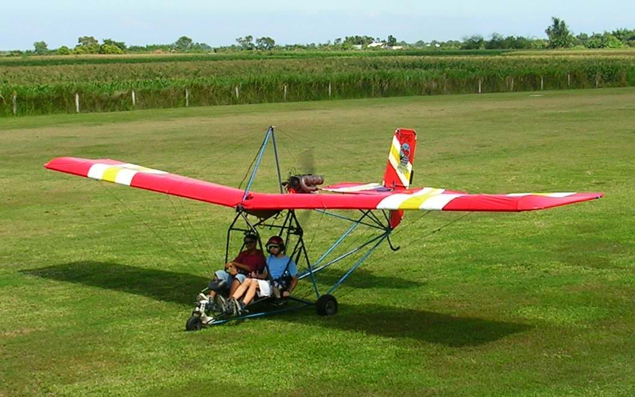
Miscellaneous Airplane Parts!

Slide 2
Agenda!
2 min - Icebreakers!
10 min - Overview of Misc. important parts of an Aeroplane
15 min - Independent Research
30 min - Your Presentations!
3 min - Closing up!

Slide 3

Icebreaker
What is your favourite movie?

Slide 4
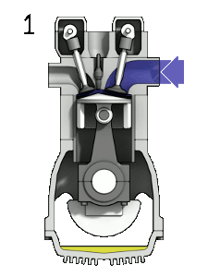
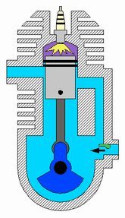
Engine
Multiple different types, most common are two-stroke engines and four-stroke engines.
Two stroke engines have more raw power, but also are far less power efficient and are less durable. They also are far worse for the environment due to the way their exhaust is released and how they utilize oil. Four stroke engines, while being more powerful, are also far heavier.

Slide 5
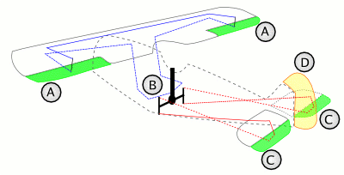
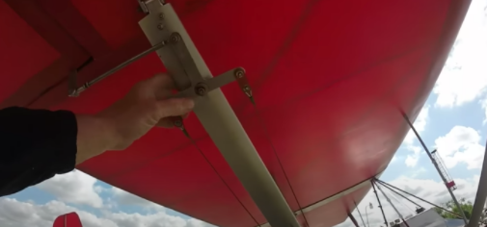
Control Cables
Cables which are attached to the planes control system (which is, in our case, a control stick (AKA a yoke). These are used to control all movement and manage parts such as the ailerons.
They are made of a variety of different materials, but are typically made of either galvanized steel or a stainless steel alloy
Very important as these are the only way we can have control over our planes flight and movement.

Slide 6
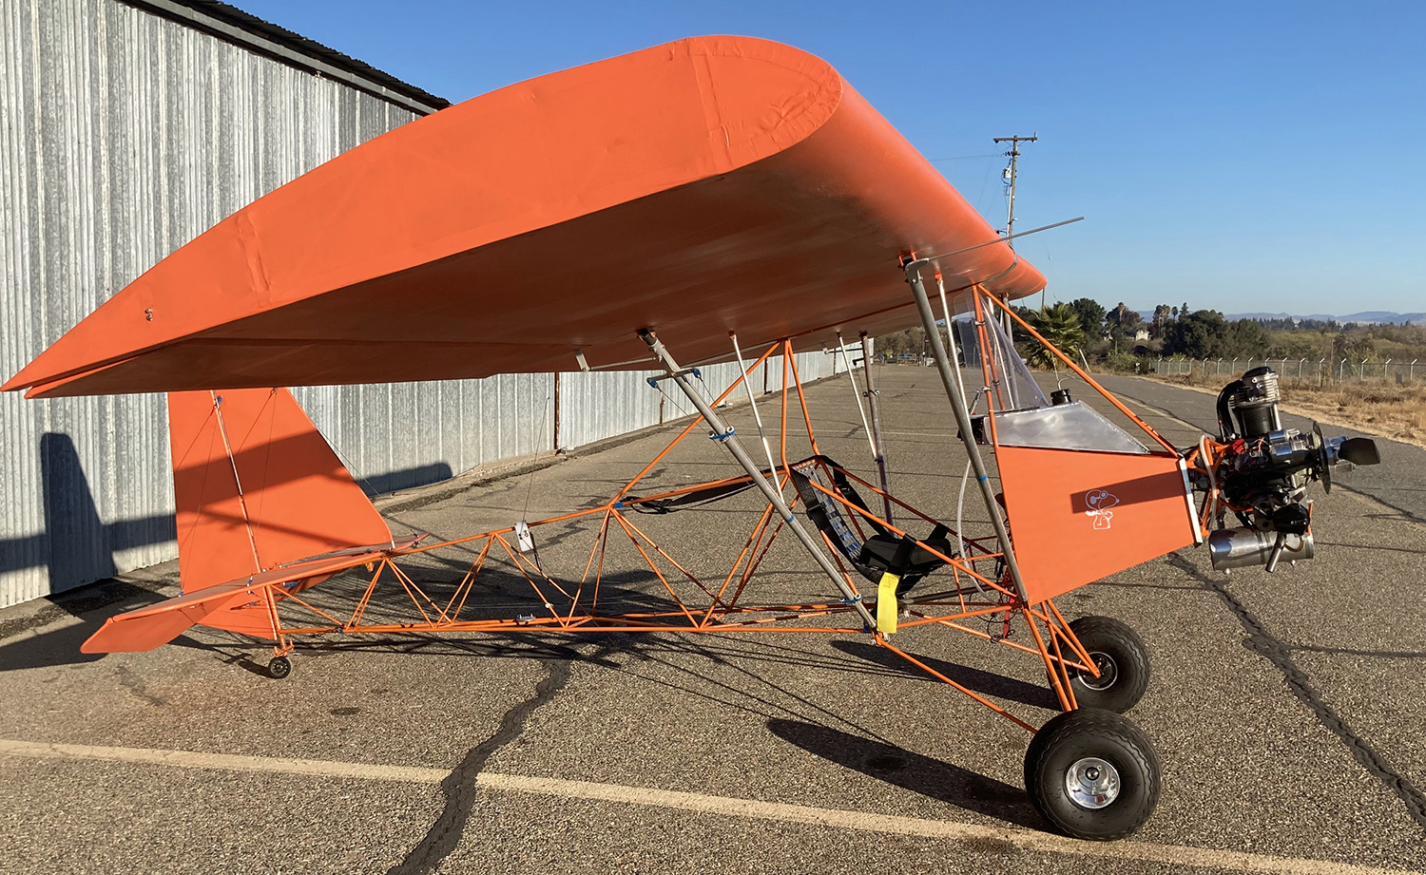
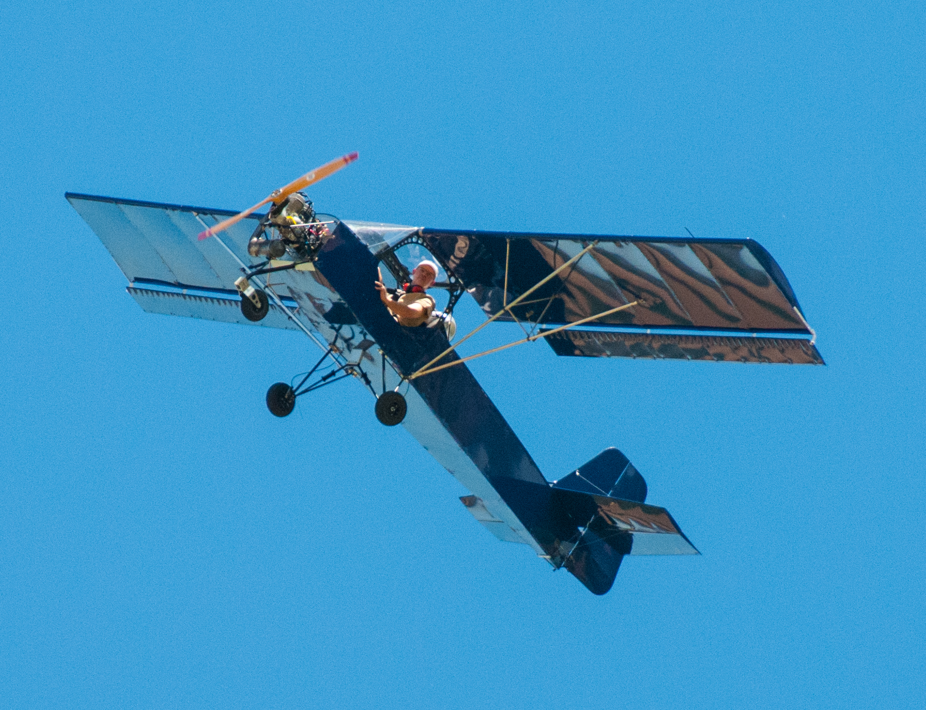
Landing Gear
There are multiple different common arrangements, but the most common one is the tricycle type arrangement (
Common on both commercial and ultralight aircrafts
This can be very harmful on rocky or rough fields, as it can be very difficult to get a smooth landing on unstable surfaces with this particular configuration

Slide 7
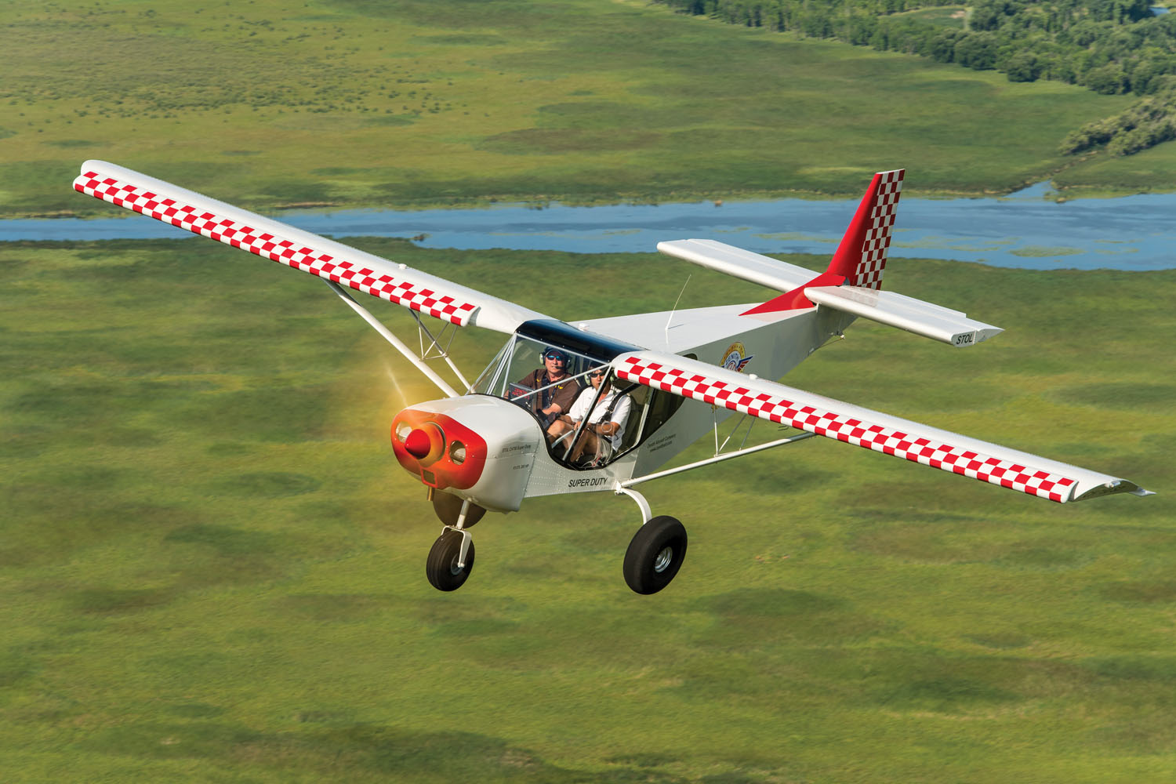
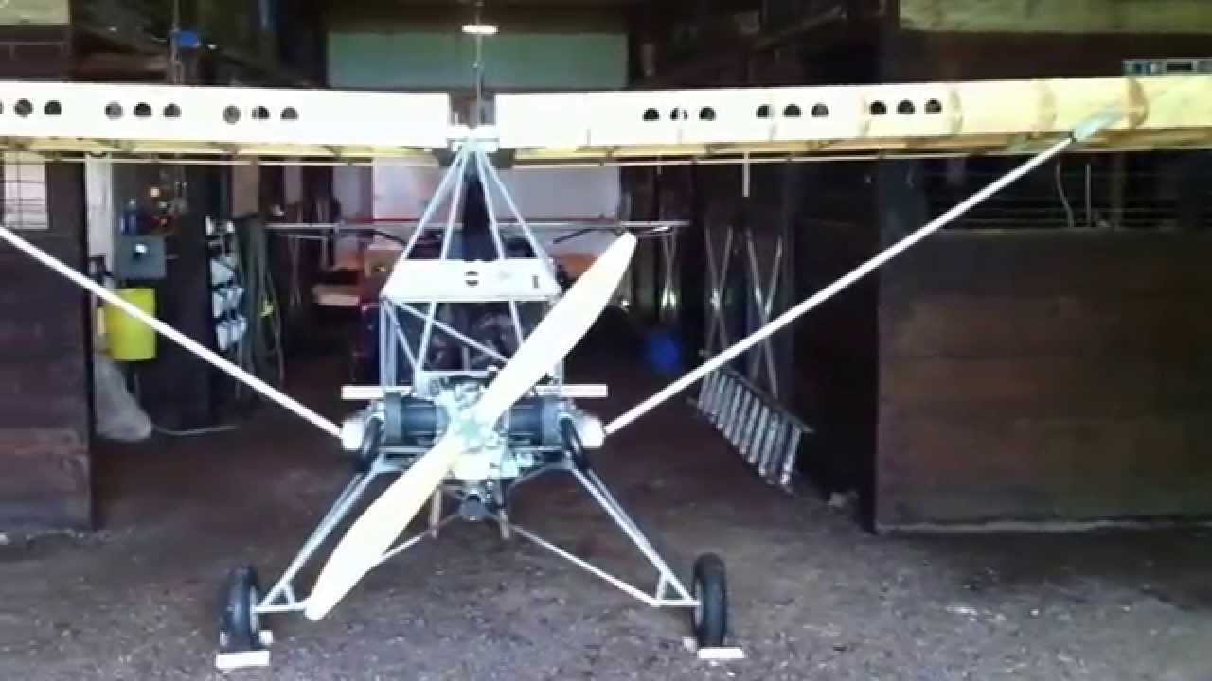
Struts
Attached to the landing gear, one is connected to each wing
Struts are generally used to dampen the impact of landing on the wings, as well as further support the stability of those wings by adding another fastening mechanism
Attached along with the control cables, and are typically made out of aluminium
Have to be attached at a very specific space on the wing - will fail if attached too close to the fuselage, and the wings will snap if attached to the tip
Cables can be used instead, but you will need far more cables than you would need struts for the same functionality

Slide 8
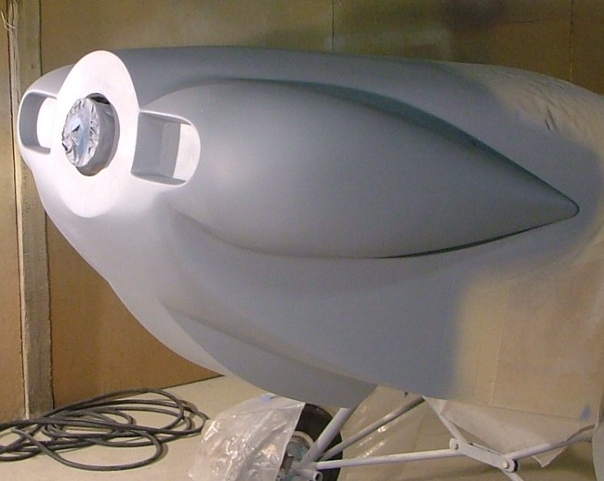
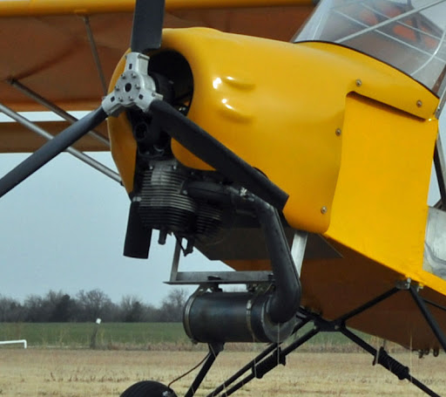
Cowling
Cowling: Cowling is a case which holds the engine of an airplane. It is typically found at the nose of the aircraft, in the same place as the engine. Aside from it’s obvious storage purposes, it is also used to streamline airflow and reduce drag, as well as ensure there is proper airflow directed towards the engine and everything is cooled properly.

Slide 9

Now it’s your turn!
Pick a specific airplane part and research it for the next 10 minutes, then give a quick, two minute presentation on what you found!

Slide 10
Applications

Slide 11
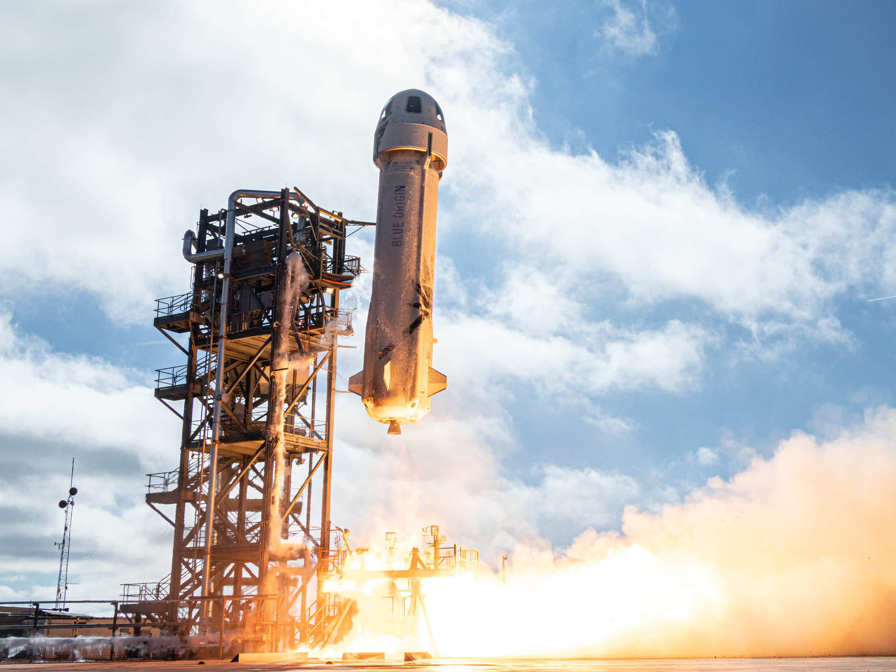
Future of Aerospace
Going back to space! (with private companies)
Blue Origin
SpaceX
Virgin Galactic
Supersonic aircraft
United Airlines is purchasing 50 supersonic jets

Slide 12
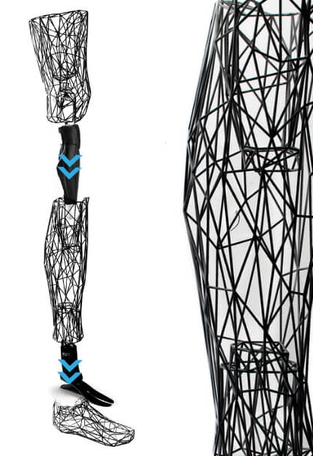
CAD
Becoming essential to engineering
Can be used for 3D printing!
Used heavily in robotics, prosthetics

Slide 13
Resources

Slide 14
Training from FCA
Resources from this summer camp (recordings & presentations): https://drive.google.com/drive/folders/1Iq_i740o0zmNAm7QY0gXvBOCaqlYY-BQ?usp=sharing
Misc. Design Team Training: https://drive.google.com/drive/folders/1xhFPnjahYh_Ihwr8o7WN2WfkdMUpvRW2?usp=sharing
Misc. Electrical Team Training: https://drive.google.com/drive/folders/1synU1HZl5xBiAtOtU78HX4MG1FxLIitB?usp=sharing

Slide 15
Learning Resources
Jeff! https://www.youtube.com/channel/UCXKW_dKcpFh358S1rV5qBDw
Compilation of everything relating to physics: https://docs.google.com/document/d/14oCnP8T2-k6qIM0NTdhdtQUyo2WPDx2JQD-v9W4yvdg/edit
Phet Lab: https://phet.colorado.edu/
EAA: http://www.eaa20.org/

Slide 16
Software
Fusion (and everything else from Autodesk): https://www.autodesk.com/education/edu-software/overview?sorting=featured&page=1
Solidworks: https://www.solidworks.com/product/students
Ansys: https://www.ansys.com/academic/students
XFLR5: https://sourceforge.net/projects/xflr5/files/
You will need this: https://docs.google.com/presentation/d/1AWKCgZYjvwBCSnMBxV08a9sHDyFfkl-l3eytjMdUTPg/edit

Slide 17
Future Steps

Slide 18
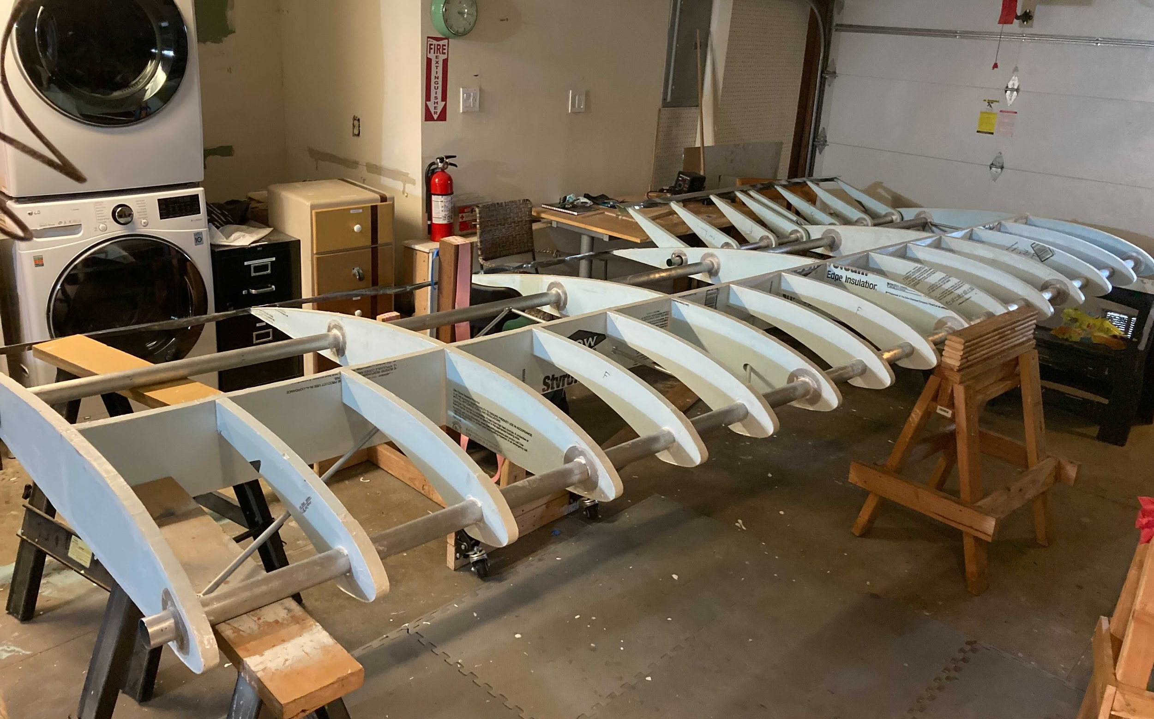
Join our team!
Interest form: https://docs.google.com/forms/d/1aMQnUPUBMCTIusxU8U20h7HNG00A6MugwTei7TxZ2pc/edit
Notes:
Note that you don’t have to know a lot, just be willing to work. And be a high schooler ofc

Slide 19
Teams & Skills
Design
Physics
Electrical
CAD (Fusion)
Research
Computational fluid dynamic simulations (AutoCAD)
Static stress simulations (Fusion)
Custom PCB design (Eagle)
Finance
Communications
Software
Graphic design (Adobe Illustrator)
Website management & design (Wordpress)
Grant research + writing
Budget management
Communication with Hack+
Avionics & sensor design
User interface (Javascript)
Notes:
Kyle - Talk about diversity of skill sets in engineering and design

Slide 20
Thank you!
Notes:
Harish

